Slide 1

Entity Component System Game Engine
Entities - ID & Mask
Components - Data
Systems - Game Logic
Managers - Engine Functionality
Custom Components and Systems
Networking
Multithreading
Oct Tree Collision Detection
Custom Maths Library
Audio
3D Rendering
- Texturing
- Normal Mapping
- Shadow Mapping??
- Particle Systems
- Directional and Point lights

Slide 2
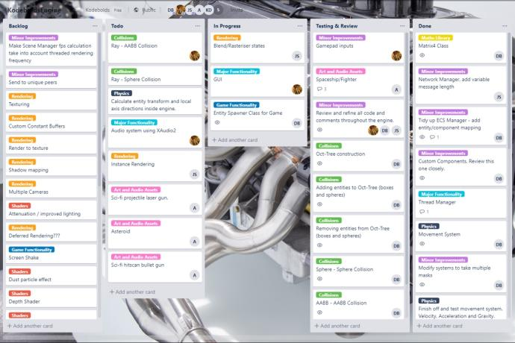
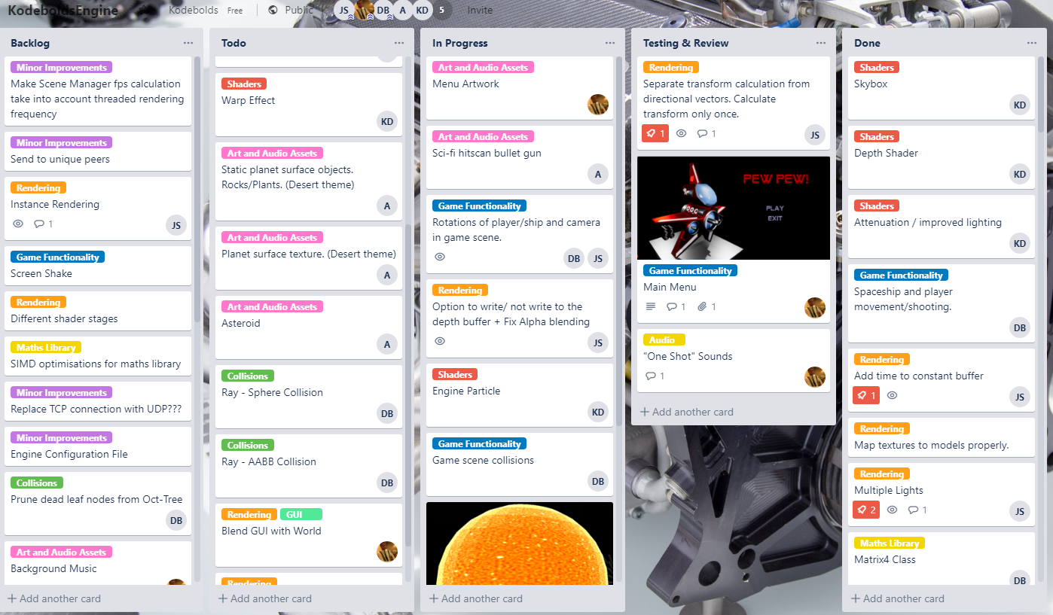
Kodebolds Team Project
Multi-Disciplinary Group
Project Management
- Trello
- Github
- Code Reviews
Artistic Quality
- 3D Assets
- Shader Effects

